Slide 1
TODO
Lada’s tests -> approval test (of the list) -> better printing
Full printed story -> whitespace -> json
Pretty printed json -> inline -> everywhere
everywhere -> single instance -> some can’t convert
dual conversations (.and) -> some can’t convert v2 -> setting state

Slide 2
Better Testing with Approvals
Llewellyn Falco
Lada Kesseler

Slide 3
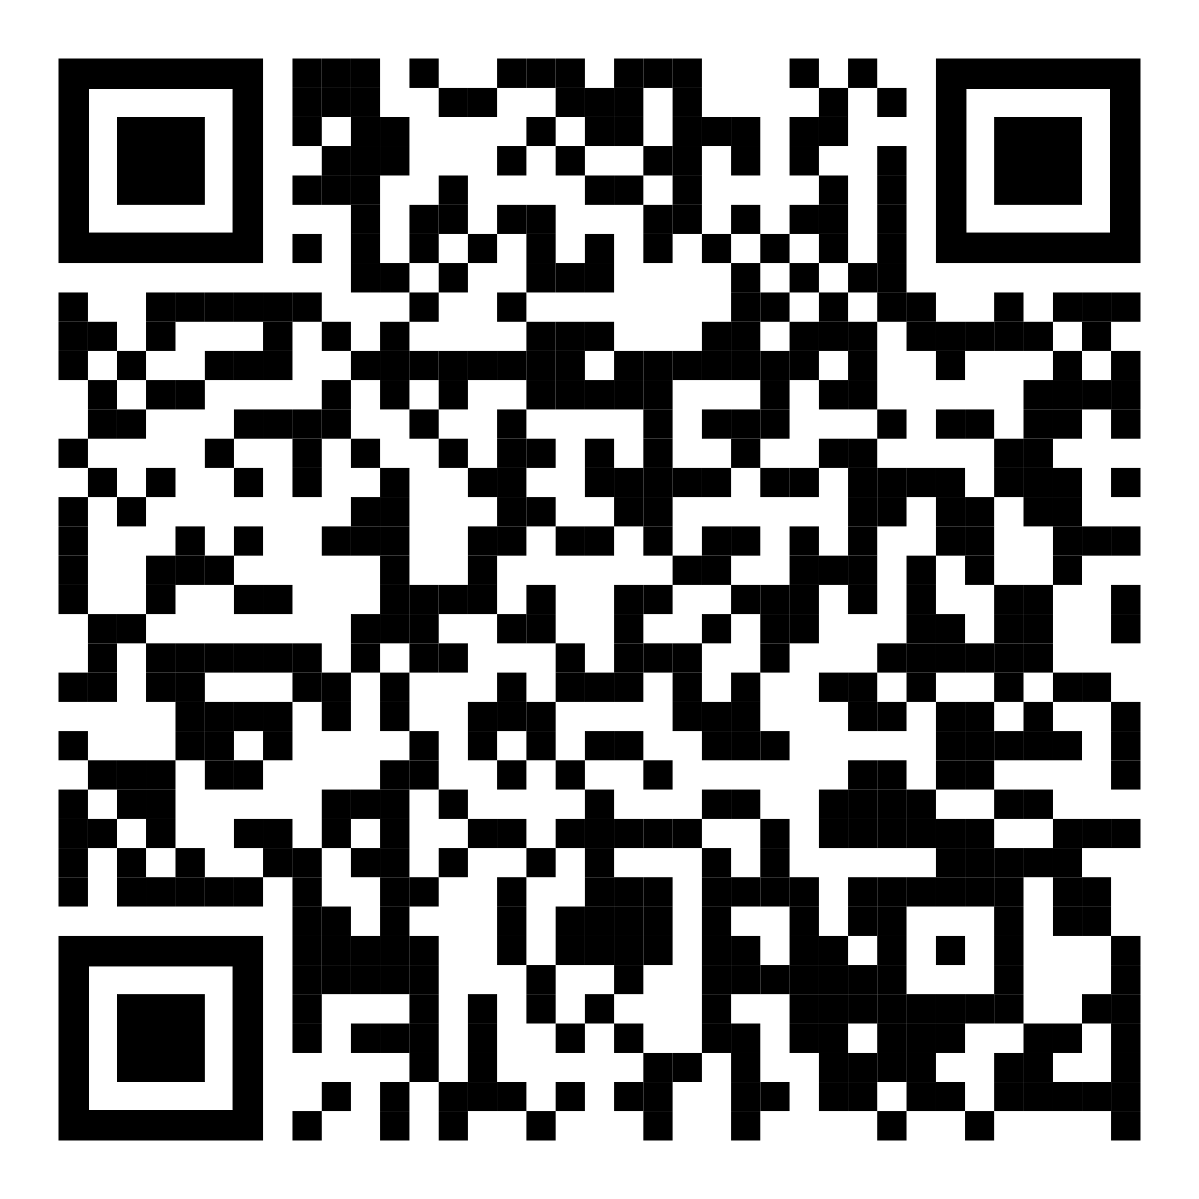
Resources
Notes:
https://github.com/isidore/Talks/blob/master/BetterTestingWithApprovals.md

Slide 4

..
..
Clear
Expressive
Simple

Slide 5

In the beginning...

Slide 6
code

Slide 7
Problem:
What the test does is confusing

Slide 8
New Concept:
Testing Circle

Slide 9
// Create side (0,0) – (3,4)
// Verify length
Whiteboard
English
Testing Circle
Result
Code
Side (0,0) – (3,4) length = 5
Side s = new Side(0,0,3,4);
Approvals.Verify(s + “ length = “ +s.Length);

Slide 10
Chat
[Customer]
hi
[Bot]
Hi there! I'm your virtual assistant.
What would you like to do today?
Notes:
we put the focus on what it is that we're testing, and not the setup of the test

Slide 11
Chat
[Customer]
hi
[Bot]
Hi there! I'm your virtual assistant.
What would you like to do today?
Whiteboard
English
Testing Circle
Result
Code

Slide 12
Chat
[Customer]
hi
[Bot]
Hi there! I'm your virtual assistant.
What would you like to do today?
// customer says ‘hi’
// verify conversation
Whiteboard
English
Testing Circle
Result
Code

Slide 13
Chat
[Customer]
hi
[Bot]
Hi there! I'm your virtual assistant.
What would you like to do today?
// customer says ‘hi’
// verify conversation
Whiteboard
English
Testing Circle
Result
Code
String userMessage = "hi"; verifyConversation(userMessage);

Slide 14
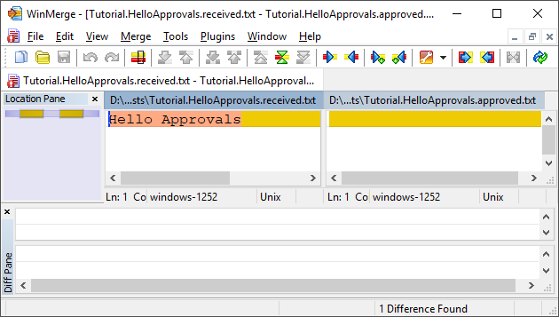
New Concept:
Approval Tests
Test + approved output

Slide 15

Chat
[Customer]
hi
[Bot]
Hi there! I'm your virtual assistant.
What would you like to do today?
// customer says ‘hi’
// verify conversation
Whiteboard
English
Testing Circle
Result
Code
String userMessage = "hi"; verifyConversation(userMessage);

Slide 16
Chat
[Customer]
hi
[Bot]
Hi there! I'm your virtual assistant.
What would you like to do today?
// customer says ‘hi’
// verify conversation
Whiteboard
English
Testing Circle
Result
Code
[Customer]: hi
String userMessage = "hi"; verifyConversation(userMessage);

Slide 17
Week 1
What happened
Notes:
Pay attention to the testing circle
Create convenience functions to hide unnecessary details

Slide 18
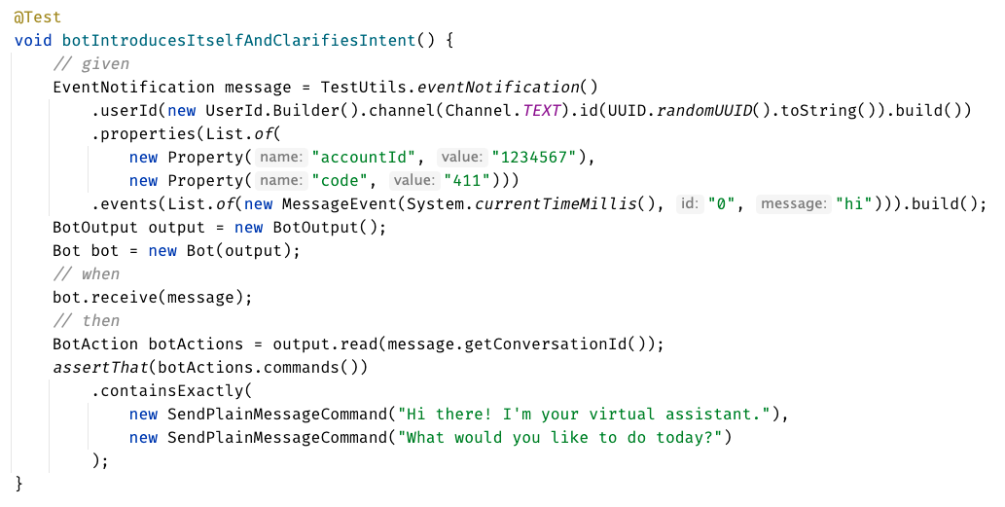

Slide 19
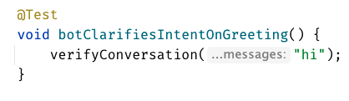


Slide 21
Week 1
learnings
Notes:
Pay attention to the testing circle
Create convenience functions to hide unnecessary details

Slide 22
...later next week...

Slide 23
code

Slide 24
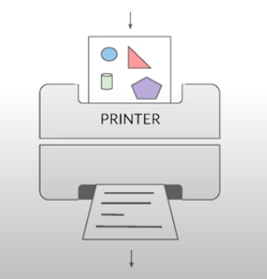
New Concept:
Printers
@EmillyBache

Slide 25

New Concept:
Story Board

Slide 26
Problem:
Lack of clarity in the test code output

Slide 27
Chat
[Customer]
hi
[Bot]
Hi there! I'm your virtual assistant.
What would you like to do today?
[Customer]
pay bill
[Bot]
Are you a customer?
Yes, I'm a customer No, I'm not

Slide 28
[Customer]: hi [ Bot]: Hi there! I'm your virtual assistant. [ Bot]: What would you like to do today? [Customer]: pay bill [ Bot]: Let me try to help you. [ Bot]: { "content": { "type": "vertical", "elements": [ { "type": "text", "text": "Are you a customer?", "tooltip": "text tooltip" }, { "type": "horizontal", "elements": [ { "type": "button", "title": "Yes", "click": { "actions": [ { "type": "publishText", "text": "Yes, I'm a customer" } ] } }, { "type": "button", "title": "No", "click": { "actions": [ { "type": "publishText", "text": "No, I'm not" } ] } } ] } ] } }
Chat
[Customer]
hi
[Bot]
Hi there! I'm your virtual assistant.
What would you like to do today?
[Customer]
pay bill
[Bot]
Are you a customer?
Yes, I'm a customer No, I'm not

Slide 29
Week 1
What happened
Notes:
Pay attention to the testing circle
Create convenience functions to hide unnecessary details

Slide 30
Formatting
[Customer]: hi [Bot]: Hi there! I'm your virtual assistant. [Bot]: What would you like to do today?
[Customer]: hi [ Bot]: Hi there! I'm your virtual assistant. [ Bot]: What would you like to do today?

Slide 31
Formatting
[Customer]: hi [Bot]: Hi there! I'm your virtual assistant. [Bot]: What would you like to do today? [Customer]: hi [Bot]: Hmmm, tell me a little more so I can help you. What would you like to do today? [Customer]: hi [Bot]: Let me try to help you. [Bot]: Are you a customer? 1) Yes, I'm a customer 2) No, I'm not
[Customer]: hi
[ Bot]: Hi there! I'm your virtual assistant. [ Bot]: What would you like to do today? [Customer]: hi [ Bot]: Hmmm, tell me a little more so I can help you. [ ]: What would you like to do today? [Customer]: hi [ Bot]: Let me try to help you. [ Bot]: Are you a customer? [ ]: 1) Yes, I'm a customer [ ]: 2) No, I'm not

Slide 32
[Customer]: hi [ Bot]: Hi there! I'm your virtual assistant. [ Bot]: What would you like to do today? [Customer]: pay bill [ Bot]: Let me try to help you. [ Bot]: { "content": { "type": "vertical", "elements": [ { "type": "text", "text": "Are you a customer?", "tooltip": "text tooltip" }, { "type": "horizontal", "elements": [ { "type": "button", "title": "Yes", "click": { "actions": [ { "type": "publishText", "text": "Yes, I'm a customer" } ] } }, { "type": "button", "title": "No", "click": { "actions": [ { "type": "publishText", "text": "No, I'm not" } ] } } ] } ] } }
[Customer]: hi [ Bot]: Hi there! I'm your virtual assistant. [ Bot]: What would you like to do today? [Customer]: pay bill [ Bot]: Let me try to help you. [ Bot]: Are you a customer? [ ]: 1) Yes, I'm a customer [ ]: 2) No, I'm not

Slide 33
Week 2
learnings
Notes:
Pay attention to the testing circle
Create convenience functions to hide unnecessary details

Slide 34
...later next week...

Slide 35
code

Slide 36
Problem:
Too many .approved. files

Slide 37
New Concept:
Inline Approvals

Slide 38
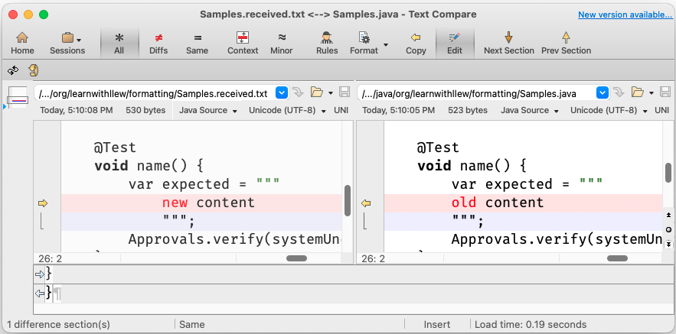
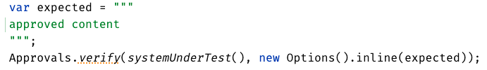
New Concept:
Inline Approvals
“Look mom, no files!”
Possible new source file
Original source file
Approved output
How to invoke
Pressing this modifies
your source code

Slide 39
Week 3
What happened
Notes:
Pay attention to the testing circle
Create convenience functions to hide unnecessary details

Slide 40
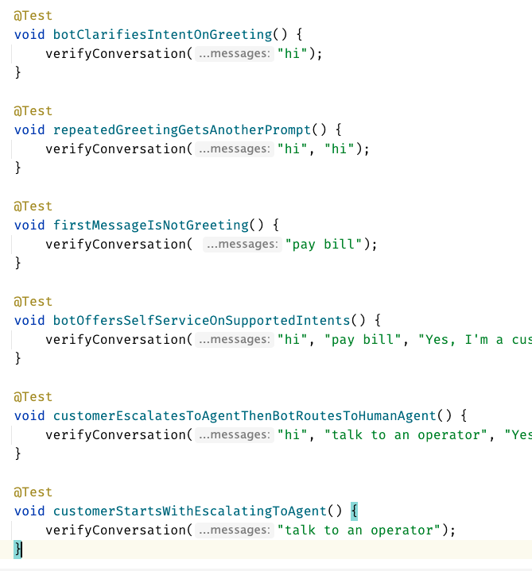
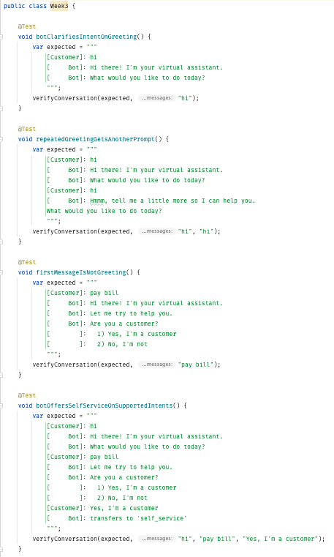
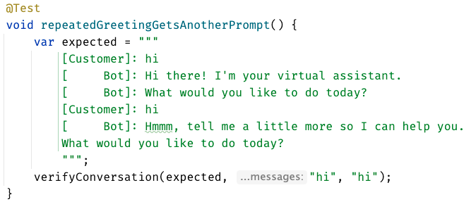
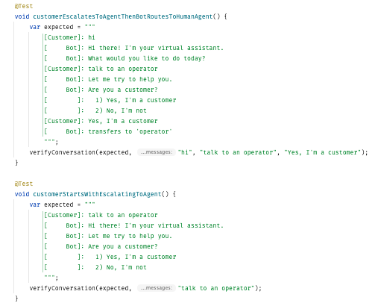
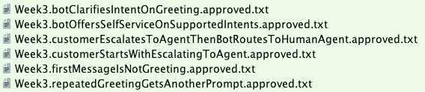

Slide 41
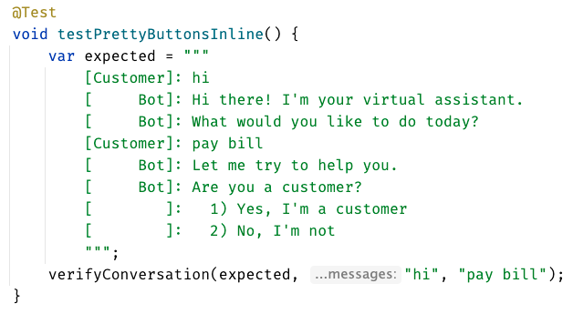
inline - everything in test

Slide 42
Week 3
learnings
Notes:
Pay attention to the testing circle
Create convenience functions to hide unnecessary details

Slide 43
...later next week...

Slide 44
code
Notes:
Hey Llewellyn, look what I did

Slide 45
Problem:
Can’t see the overall test strategy
hard to see if you’re missing cases...

Slide 46
New Concept:
verifyAll()

Slide 47
New Concept:
many of one

Slide 48
Week 4
What happened
Notes:
Pay attention to the testing circle
Create convenience functions to hide unnecessary details

Slide 49
Remember this:
When you have a lot of similar scenarios, allow yourself to see both the forest and the trees
Notes:
Stay on the same level of abstraction as the testing circle

Slide 50
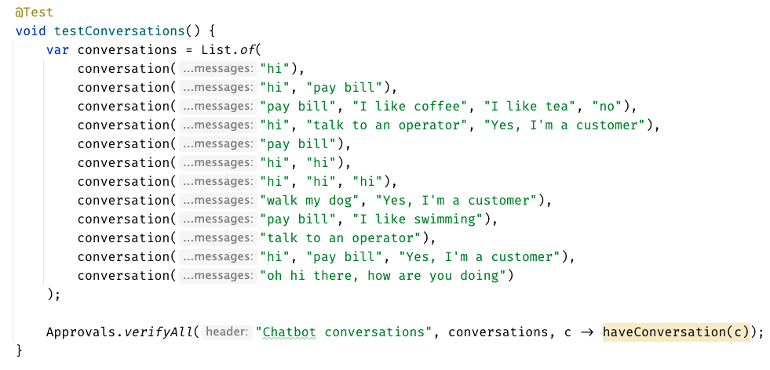

Slide 51
Week 4
learnings
Notes:
Pay attention to the testing circle
Create convenience functions to hide unnecessary details

Slide 52
...later next week...

Slide 53
code
Notes:
Hey Llewellyn, look what I did

Slide 54
Problem:
95% of tests are together
but 5% are alone...

Slide 55
New Concept:
Custom test scenario builders
creating Domain-Specific Language (DSLs)

Slide 56
Week 5
What happened
Notes:
Pay attention to the testing circle
Create convenience functions to hide unnecessary details

Slide 57
var conversation1 = conversation("pay bill", "Yes, I'm a customer"); var conversation2 = conversation("pay bill"); var conversations = List.of(conversation1, conversation2);
conversation("pay bill", "No, I'm not") .thenConversation("pay bill")

Slide 58
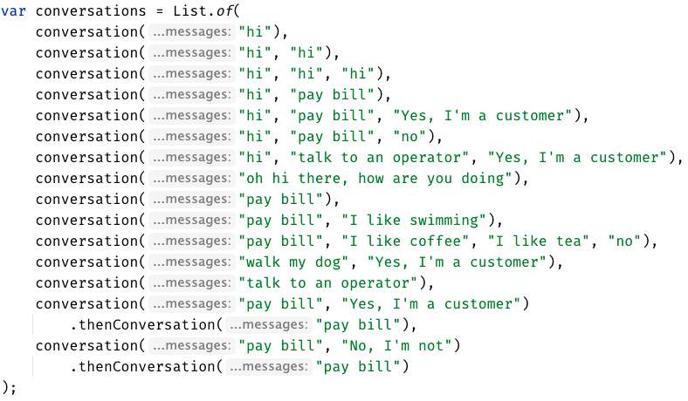

Slide 59
Week 5
learnings
Notes:
Invest in APIs that make it easier to express test scenarios

Slide 60
...later next week...

Slide 61
code
Notes:
Hey Llewellyn, look what I did

Slide 62
Problem:
The tests are only for developers

Slide 63
New Concept:
Alternative .approved. files
new Options().forFile().withExtension(".md")
Notes:
stakeholders

Slide 64
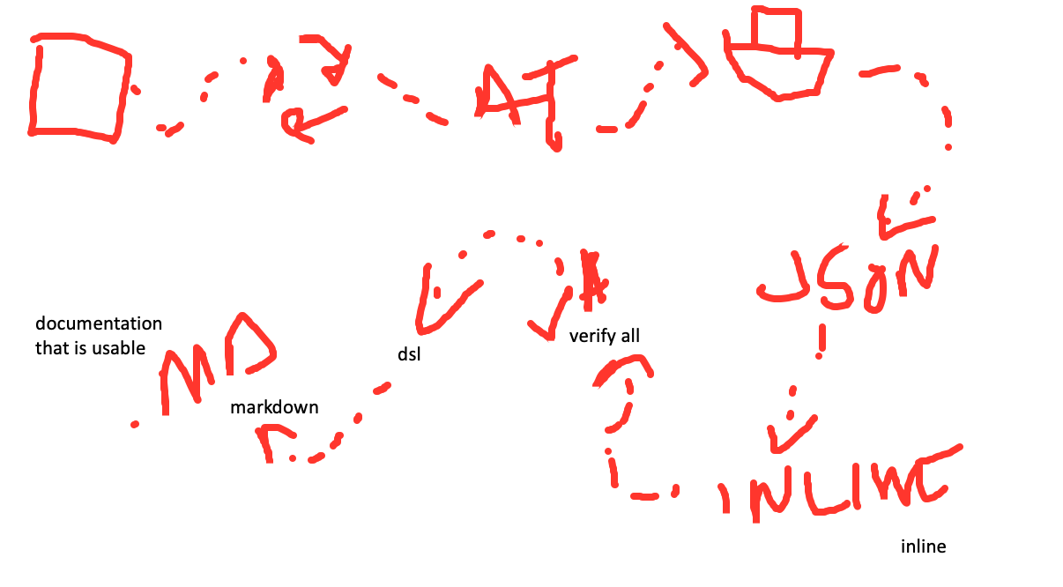
how you can iterate over time and improve your tests (using approval tests)

Slide 65
how you can iterate over time and improve your tests (using approval tests)

Slide 66
Complex
Tests
Approval
Tests
Test
Circle
Printers & Story Board
document
that is usable by stakeholders
JSON
markdown
verify all
expressive domain dsl
Inline

Slide 67
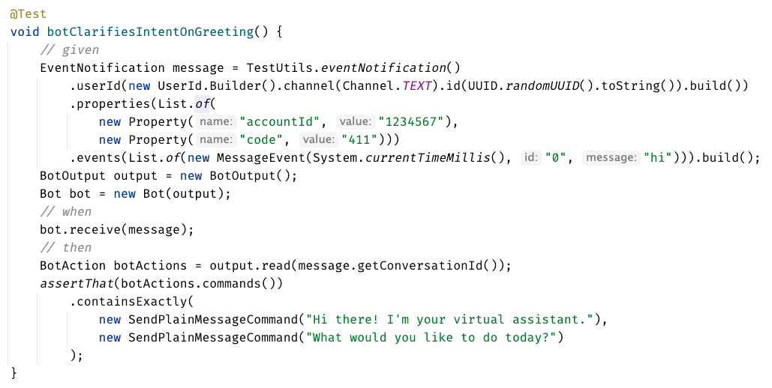
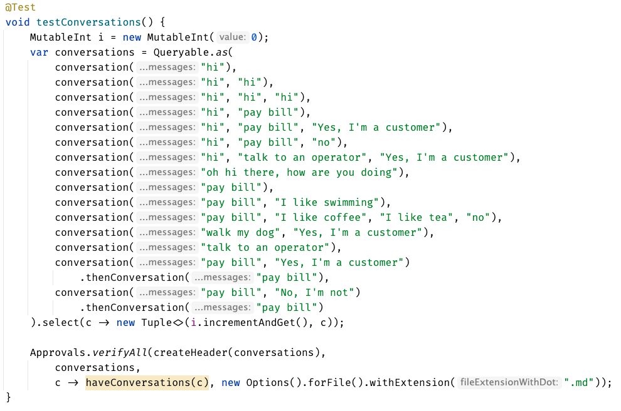

Slide 68
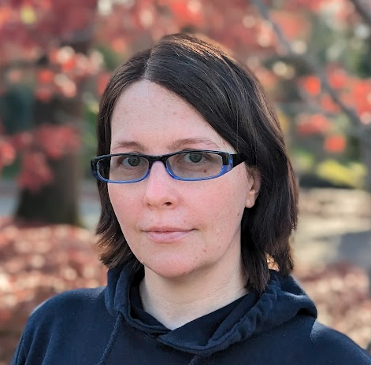

Slide 69
can see only
up to here
foggy
as the details disappear,
we get to see the next layer
person

Slide 70
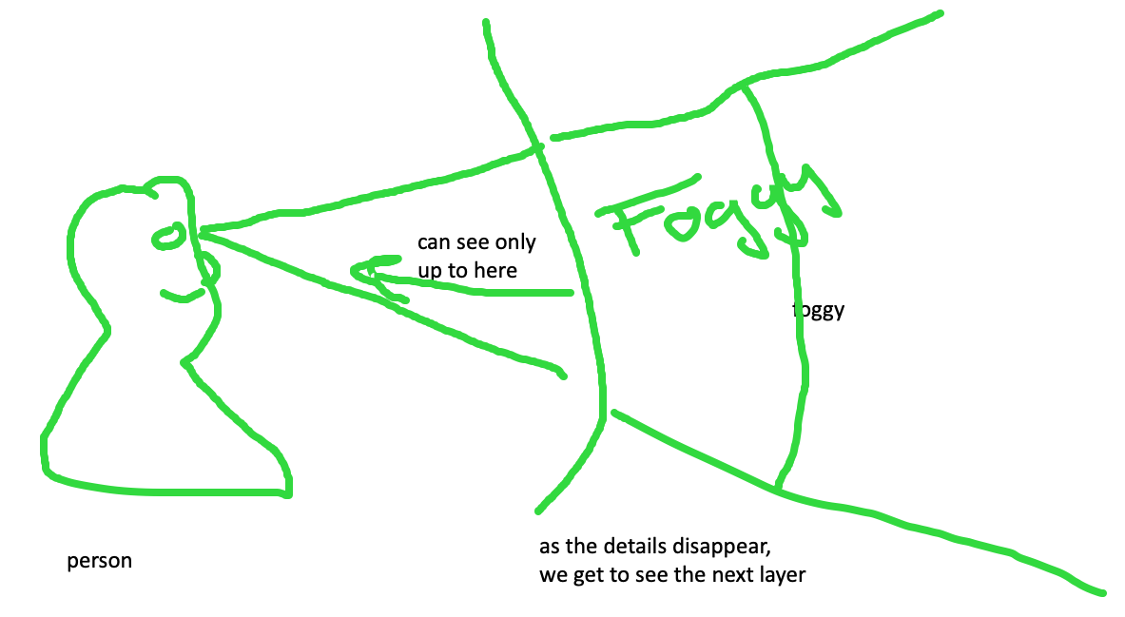
feedback loop – too hard and impossible is the same thing, stop to look

Slide 71
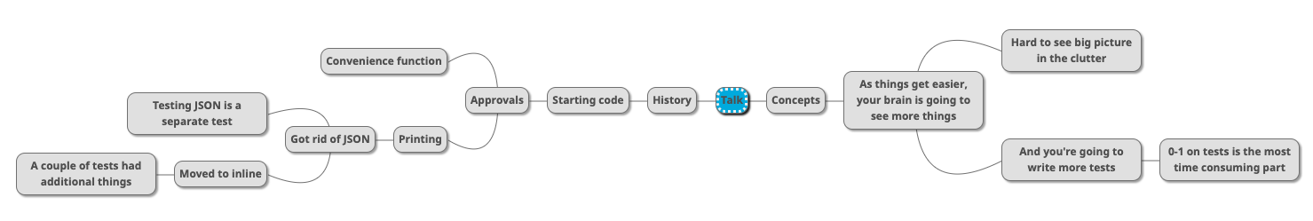

Slide 72
Rest Calls

Slide 73
Consider paths we took:
wordy Java tests
made a printer
made a good printer – not a json: Json test // TODO the json tests
made the inlining – makes it easier to read the whole test better
did multiple conversations
now we can see individual tests, but we can’t see the big picture – so we moved it to the uber test – can delete the other files

Slide 74
Original
@Test public void shouldGetCustomerFromService() { // given accountType = CustomerAccountTypeInfo.builder().account(ACCOUNT_ID).accountType(”PERSONAL").subscription(”MONTHLY").build(); when(responseEntity.getBody()).thenReturn(accountType); // when CustomerAccount result = customerService.retrieveAccount(ACCOUNT_ID); // then CustomerAccount expectedCustomerAccount = new CustomerAccount(ACCOUNT_ID, CustomerPaymentType.MONTHLY, "PERSONAL"); assertThat(result, is(expectedCustomerAccount)); verify(restTemplate, times(1)).exchange(calledUrlCaptor.capture(), eq(HttpMethod.GET), sentHttpEntityCaptor.capture(), any(Class.class)); verifyHeadersAreValid(sentHttpEntityCaptor.getValue().getHeaders()); }

Slide 75
Approval Text
Recorded call to : Conversation Details API
REQUEST
--------------------------------------------------------------------------------
Method : GET
Called Url: /api/v1.2/message/id/500
Headers :
{
"Authorization" : [ "Basic fake" ],
"Cache-Control" : [ "no-cache" ]
}
Body :
null
EXAMPLE RESPONSE
--------------------------------------------------------------------------------
{
"data": [
{
"displayNumber": "500",
"encodedCaseDisposition": 27,
"uuid": "uuid-1",
"createDate": 0,
"responsePortalLink": "/portal/message/500",
"primaryMessage": {
"conversationDisplayId": "500",
"network": "twitter",
"networkInstance": "twitter",
"receiveDate": 0,
"publishDate": 0,
"tags": [
],
"private": true
},
"messages": [
{
"conversationDisplayId": "500",
"network": "twitter",
"networkInstance": "twitter",
"receiveDate": 0,
"publishDate": 0,
"tags": [
],
"private": true
}
],
"tags": [
{
"creator": {
"type": "BOT"
},
"tagId": "34",
"uuid": "uuid2"
}
],
"priority": 4,
"lswPermalink": "/console/bot/500",
"totalResponses": 2,
"hasResponse": false,
"status": "IN_PROGRESS"
}
]
}

Slide 76
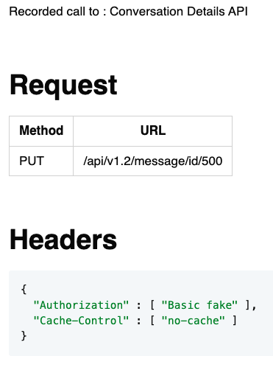
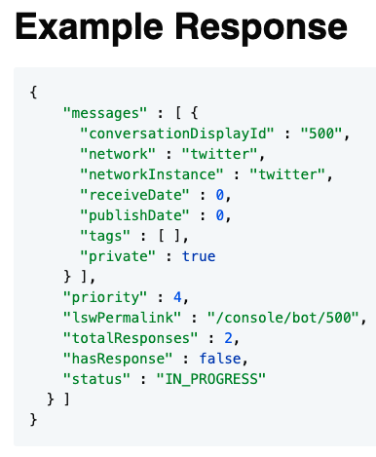
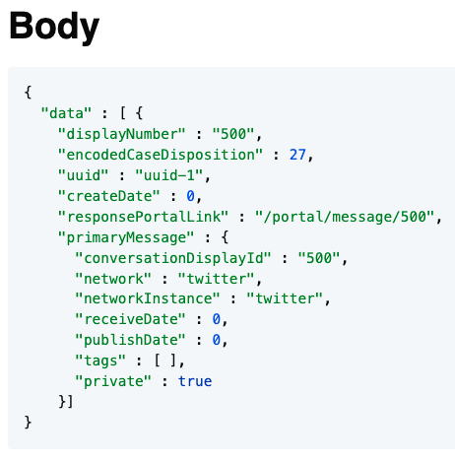
Approval Markdown
2-5 min - Lightning talk?

